Slide 1
Healthcare Financing
Jonathan Markle

Slide 2
Terminology
Non-market institutions: circumstances, structures, beliefs, etc. that make an economic sector not adhere to the classic supply-demand function (BOARD DRAWING HERE, SD curve)
Market failure: price insensitivity from the patient or provider along with the inability to dictate pricing (patients don’t care how expensive a test is if they do not bear its cost; providers cannot dictate prices)
You can see market failure when different hospitals charge wildly different amounts for similar services
Risk pool: insurance term for grouping together people of similar health and pre-existing conditions under similar rates in the hopes of making profit (ex. healthy 30-ish men can often get $500,000 life insurance policies for under $20 a month; the life insurance company is confident the man won’t die anytime soon) (BOARD DRAWING HERE, pool analogy)

Slide 3
Healthcare: Not a Classical Market
Healthcare consumers do not demand a given amount of healthcare; they just want to get well (no one says “I would like three ER visits and four injectable medical marijuanas”)
Other non-market institutions like physician trust and professionalism are present (patients trust in the amount of services that providers dictate)
Physicians (hopefully) do not act as conventional product sellers; maximum profit is not the goal (ex. If you have the flu they won’t prescribe you 180279427 Tamiflu doses)
Costs are not borne exclusively by either the patient or provider; insurance organizations draw funds collected in their pools

Slide 4
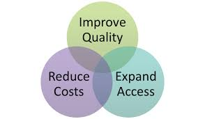
A Review: Three Big Competing Priorities
Access
Should everyone receive services, and if so should all people receive the same services or should some receive more than others?
Cost
Government wants to keep costs down (deficits, taxes, etc.)
Insurance and medical device companies want to make a profit
Providers may be reimbursed less when dealing with patients with “lesser” insurance (a cost to themselves if you will)
Who should bear the burden of cost maintenance?
Quality
Higher costs =! Better quality
What incentives should we give patients, providers, the private sector, etc. to put quality first? And will these incentives interfere with the other two above incentives?

Slide 5
U.S. Finance and Payment History
WW2: Government price freezes lead to the rise of employer health insurance as a recruiting tool (increasing access)
1960s: Medicare and Medicaid expand care access to millions (increasing access)
1973: HMOs arise (managing cost)
1984: DRG hospital payments (managing cost)
1990s: Arise of capitation of physician managed care (managing cost and improving quality with “efficient” networks)
2001: Pay for performance (incentivizing quality)
2003: “Rise” of Health Savings Accounts (managing cost on the consumer level)
2010: ACA (tries to do all three)

Slide 6
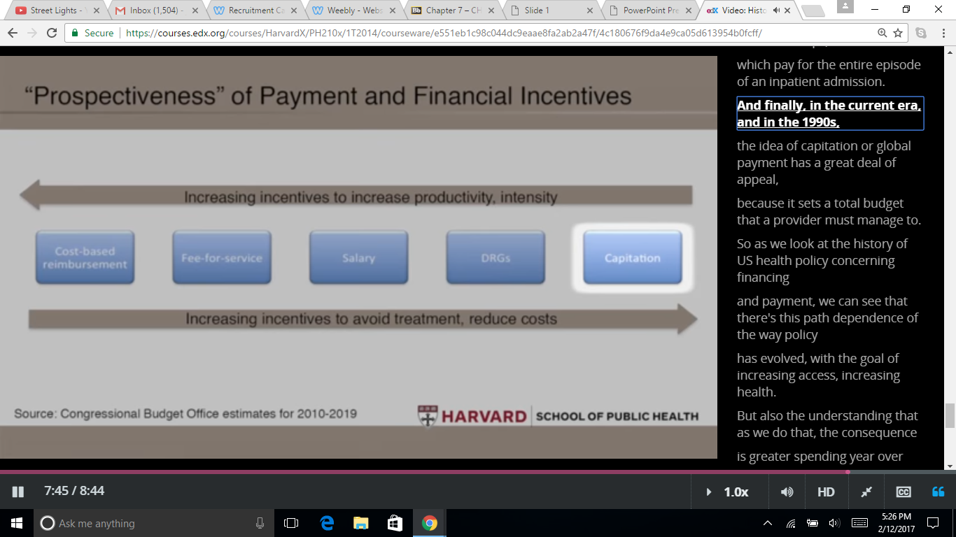
Financial Methods to Manage Priorities:
All of these methods fall within the domain of payment reform and do not necessarily overlap with other reform efforts previously talked about
CBR: retrospective payment for services
FFS: services are unbundled and paid for separately
DRG: “diagnosis-related group” (paying the average amount for a certain diagnosis)
Capitation: giving a block amount of money for reimbursement (a budget where the cost-saving onus is on who receives the grant)
Financial models based on greater access and higher reimbursement
Financial models based on higher quality and cost reduction

Slide 7
So the Questions Are...
Which of the “Three Big Competing Priorities” should come first, or should we prioritize all of them, or two of the three? Is it even possible to prioritize more than one simultaneously?
Which finance methods will best achieve what we prioritize?
What non-finance reforms will best achieve what we prioritize (some described in previous presentations)?
Will the American people accept anything other than trying to fix everything at once?

Slide 8
Evidence for Payment Incentives
U.S. system has been trending toward financial models based on higher quality and cost reduction
Changes from FFS to salary/capitation have resulted in large volume decreases in certain kinds of services provided (usually less-reimbursed procedures) and vice versa for the opposite
UTILIZATION OF A GIVEN MEDICAL SERVICE AND REIMBURSEMENT LEVELS HAVE A DIRECTLY PROPORTIONAL RELATIONSHIP (not necessarily a bad thing!)
Pay-for-performance/quality incentives have had only modest cost effects
Maybe they haven’t been in place long enough (still a relatively recent development)

Slide 9
ACA and Current Trends
Increasing bundled care (more services included in a single payment; follows a capitation model)
Enforced via experimental Accountable Care Organizations (ACOs)
Heart failure is an area particularly targeted by this bundling
Hospital readmission reduction programs target quality of care
Physician “value-based modifier” program rewards physician groups of 100+ that demonstrate “high quality and low cost”
Experiments by both Medicare and the private sector to promote “integration and the reduction of waste”
Trend toward “centers” for certain conditions http://www.crainscleveland.com/article/20170212/NEWS/170219962/cleveland-clinics-new-276-million-cancer-hub-boasts-a-pod-approach?utm_campaign=socialflow&utm_source=twitter&utm_medium=social
Tries to target all three priorities simultaneously (7:12 to end of this video is a nice wrap-up) (https://courses.edx.org/courses/HarvardX/PH210x/1T2014/courseware/e551eb1c98c044dc9eaae8fa2ab2a47f/c7ee23637ada4f25854d986420c9ae7a/)

Slide 10
Interview Questions
What is the one thing you would change about the American healthcare system?
What are the four main provisions of the ACA that are designed to target the priorities discussed in this presentation? (Unless you’ve done your own research you won’t know this until at least next week)

