Slide 1
The CASPer Test

Slide 2
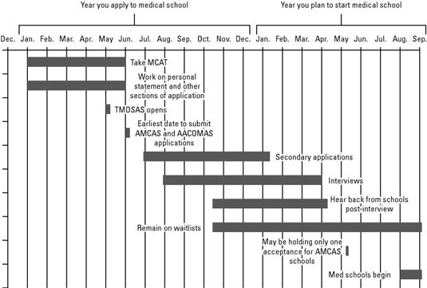

Slide 3
The Basics
An Online test designed to evaluate key personal characteristics that make for successful students
Delivered by Altus Assessments
~90 minutes
Optional 15 minutes break at the halfway point
12 sections

Slide 4
Developing CASPer
Designed by admissions committee members
Traditional applications fail to give admission committees a true sense of who YOU are/ a sense of your non academic attributes
Attempted to “even the playing field” for applicants
Research done to show that CASPer tests for non academic attributes

Slide 5
Why use CASPer?
Looking beyond cognitive factors
Holistic review of the applicant
CASPer assesses for professionalism, communication skills, ethics, motivation, etc.
Who uses CASPer?

Slide 6
Osteopathic
Allopathic

Slide 7
Test Accessibility
Can be taken on your personal computer/laptop
Must have a webcam
Altus Assessments schedules, administers, & scores the test through takecasper.com
$10 base fee
$10 fee to distribute to EACH program
*CASPer fees are waived for those approved for the AAMC-Fee Assistance Program*

Slide 8
Content
Situational judgement test (SJT)
12 scenarios
Either video-based or word-based
You are presented with your role in the scenario
3 open ended questions per scenario
5 minutes per scenario
Do not require knowledge of the healthcare field
https://takecasper.com/sample-casper-content/

Slide 9
Scoring of the Test
Timeline: 3 weeks
12 independent raters
One rater per session
Raters know nothing about your secondaries, MCAT, GPA, or other 11 CASPer scenario answers
Come from all different backgrounds - not all healthcare
“Halo effect” - unintended first impression bias
Your performance on one question does not impact your performance on the next question
You are marked relative to your peers
12 independent scores are combined for your overall score
You do NOT receive your score

Slide 10
Questions?

